Slide 1
Al-Driven Public Health Chatbot for Disease Awareness
CSE7101- Capstone Project
Review-5
Batch Number : CSG_16
Under the Supervision of,
Mr. Asif Ahmad Najar
Assistant Professor
School of Computer Science and Engineering
Presidency University
Roll Number | Student Name
20221CSG0020 | S MOHAMMED AFFAN
20221CSG0059 | KARTHIK MP
20221CSG0092 | CHAITHRA C
Name of the Program: CSG-Computer Science & Technology(AI ML)
Name of the HoD: Dr . Pallavi
Name of the Program Project Coordinator: Ms Benitha Christinal J
Name of the School Project Coordinators: Dr. Sampath A K , Dr. Geetha A

Slide 2
Abstract
Access to reliable and up-to-date healthcare information remains a major challenge in rural and semi-urban areas due to limited infrastructure and widespread misinformation. This project proposes an AI-based public health chatbot that delivers accurate and accessible healthcare awareness using Retrieval-Augmented Generation (RAG) combined with FAISS-based semantic search. The system provides symptom awareness, drug information, and hospital discovery through WhatsApp integration while ensuring safe, non-diagnostic, and context-aware responses.

Slide 3
Introduction
Healthcare accessibility gaps, especially in rural areas, often lead people to rely on unverified sources, resulting in delayed treatment and poor health decisions. With the growing use of smartphones and messaging platforms like WhatsApp, there is an opportunity to provide structured and reliable healthcare information through conversational AI. However, standalone AI models can produce incorrect information, making it necessary to design a system that ensures accuracy and safety.

Slide 4
Literature Survey
Existing healthcare chatbots are either rule-based systems with limited flexibility or AI-based systems that suffer from hallucination and lack of reliability. Research shows that Retrieval-Augmented Generation improves factual accuracy by grounding responses in verified documents. However, most existing systems lack structured routing, safety mechanisms, and real-time healthcare integration, highlighting the need for a more reliable and comprehensive solution.

Slide 5
Literature Survey (10 papers)
Ref. No. | Authors & Year | Focus Area | Approach Used | Key Contribution | Identified Gap
[1] | Laranjo et al., 2018 | Healthcare conversational agents | Systematic review of rule-based and AI chatbots | Validated role of chatbots in patient education and engagement | Limited contextual intelligence and weak evaluation standards
[2] | Bickmore et al., 2018 | Safety in health chatbots | Design-focused conversational frameworks | Emphasized need for safety guardrails and non-diagnostic responses | No technical grounding mechanism for response validation
[3] | Wilson & Marasoiu, 2022 | Public health chatbot deployments | Scoping review | Demonstrated scalability for health awareness campaigns | Mostly rule-based, limited NLP sophistication
[4] | Branda et al., 2025 | AI chatbots in emergencies | Narrative review | Highlighted outbreak communication effectiveness | Lack of structured factual grounding and reliability control
[5] | Singhal et al., 2023 | Medical knowledge in LLMs | Evaluation of medical LLM performance | Demonstrated strong clinical reasoning capability | Hallucination and unverifiable outputs remain concerns
[6] | Ji et al., 2023 | Hallucination in NLP | Survey analysis | Identified hallucination types and mitigation techniques | No universal mitigation for healthcare-critical contexts
[7] | Lewis et al., 2020 | Retrieval-Augmented Generation | Dense retrieval + generative model | Introduced RAG framework improving factual grounding | General-domain focus, not healthcare-specific
[8] | Izacard & Grave, 2021 | Retrieval-enhanced QA | Passage retrieval + encoder-decoder | Improved answer accuracy using retrieval grounding | Lacked healthcare safety constraints
[9] | Miner et al., 2020 | Pandemic chatbots | Review of COVID-19 chatbot deployments | Demonstrated scalability during crisis communication | Mostly scripted systems with limited adaptive reasoning
[10] | Devaraj et al., 2022 | Evidence-based decision support | NLP + document retrieval system | Promoted document-backed AI support | No conversational public-facing interface

Slide 6
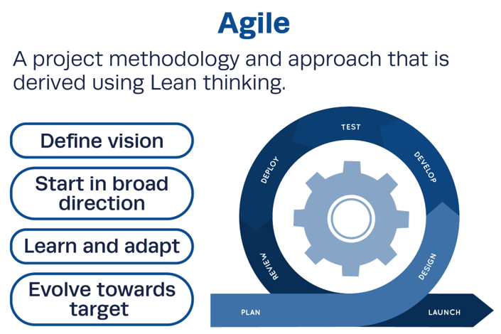
Methodology model

Slide 7
Methodology
The project follows an Agile Scrum methodology for iterative development and improvement. The system workflow includes knowledge base preparation, semantic embedding generation, FAISS vector storage, query processing, and Retrieval-Augmented Generation for response creation. A deterministic routing mechanism directs user queries to appropriate modules, ensuring context-aware, accurate, and safe responses.

Slide 8
Project Management
The project was managed using structured Agile practices with clearly defined phases including planning, development, testing, and evaluation. Project management involved timeline scheduling, risk analysis, and resource allocation. Continuous monitoring and iterative improvements ensured that the system met functional and performance requirements effectively.

Slide 9
Analysis and Design
The system is designed using a modular architecture that includes components such as a medical router, symptom analysis tool, drug intelligence module, hospital finder, and RAG-based knowledge engine. The backend is implemented using FastAPI, and the system integrates FAISS for semantic search and WhatsApp for user interaction, ensuring scalability, maintainability, and efficient performance.

Slide 10
Hardware and Software
The system requires basic hardware such as a computer with internet connectivity. The software stack includes Python for development, FastAPI for backend services, LangChain for orchestration, HuggingFace for embeddings and language models, FAISS for vector storage, and external APIs such as Twilio for WhatsApp integration and Google Places API for hospital location services.

Slide 11
Evaluation and Results
The implemented system demonstrates effective performance in terms of accurate query routing, context-aware response generation, and reduced hallucination through RAG-based grounding. It successfully provides real-time hospital discovery and maintains fast response times, making it suitable for practical deployment in real-world healthcare awareness applications.

Slide 12
Evaluation and Results
Example User Queries and Chatbot
Responses
Comparison with Traditional Search Systems
User Query | Retrieved Context Source | Chatbot Response Summary
Symptoms of dengue? | FAISS medical document | Provides symptoms like fever, headache, joint pain
Prevent malaria? | Preventive knowledge base | Suggests mosquito control and hygiene
What is paracetamol? | Drug corpus | Explains usage and precautions
Persistent cough? | Symptom database | Gives possible causes + doctor advice
Find hospital | API tool | Returns nearby hospitals
Evaluation Factor | Traditional Search Engine | Proposed Chatbot System
Information Access | Multiple sources | Direct answers
Response Structure | Links | Structured response
Context Awareness | Low | High (RAG-based)
Risk of Misinterpretation | High | Low
User Effort | High | Low
Response Time | 20–60 sec | 2–4 sec

Slide 13
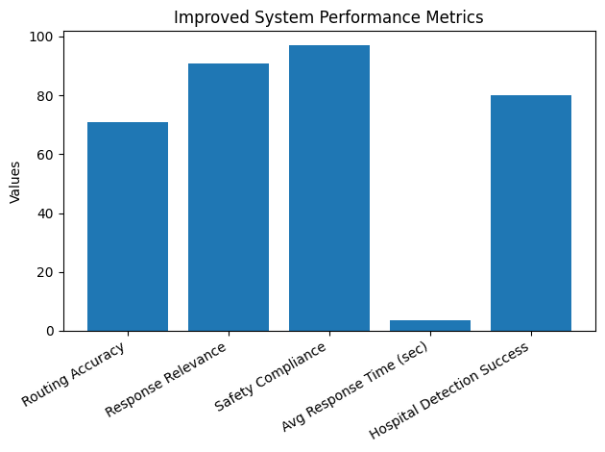
Evaluation and Results
Performance Evaluation Metrics
Metric | Value | Description
Routing Accuracy | 71% | Correct module selection
Response Relevance | 91% | Matches user intent
Safety Compliance | 97% | Emergency handling
Average Response Time | 3.7 sec | End-to-end latency
Hospital Detection Success | 80% | Location-based results

Slide 14
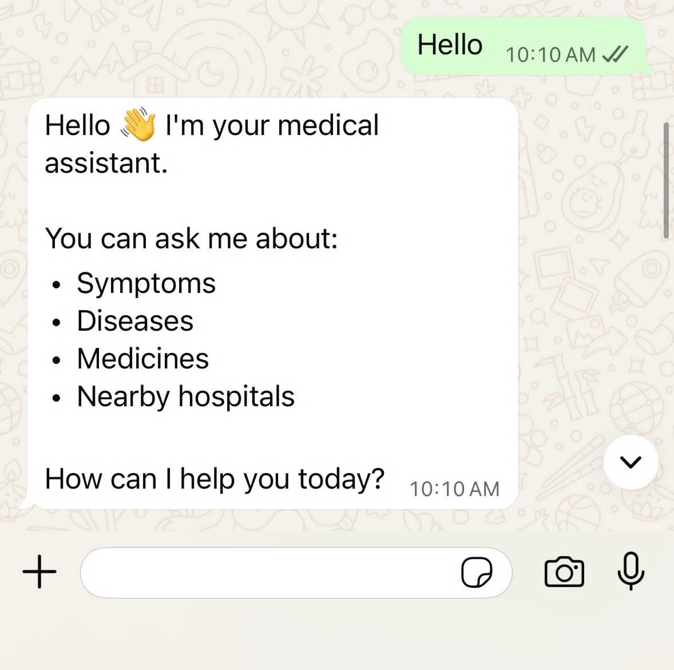
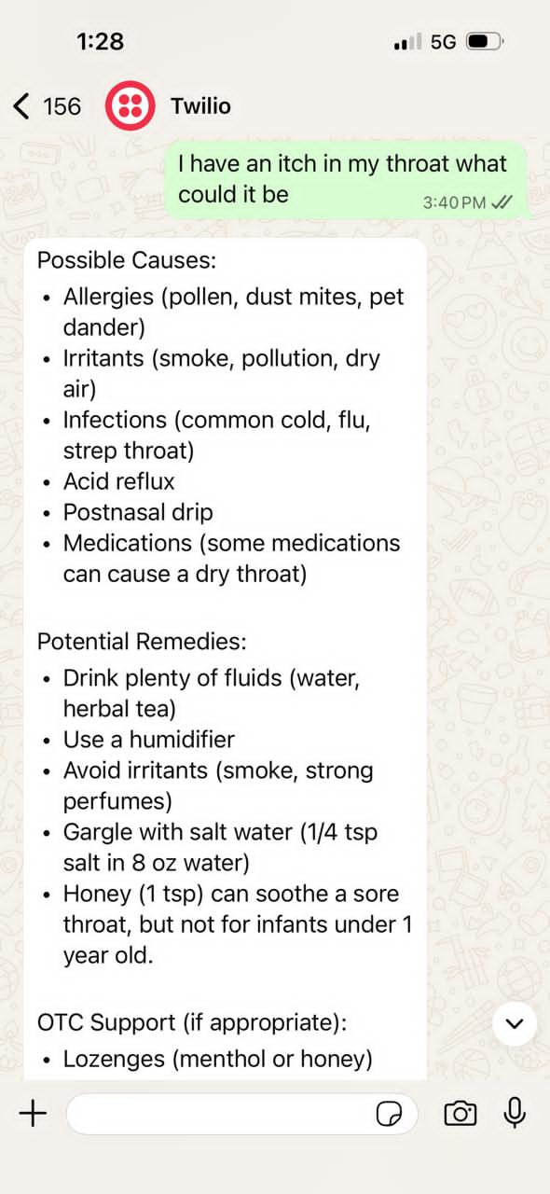
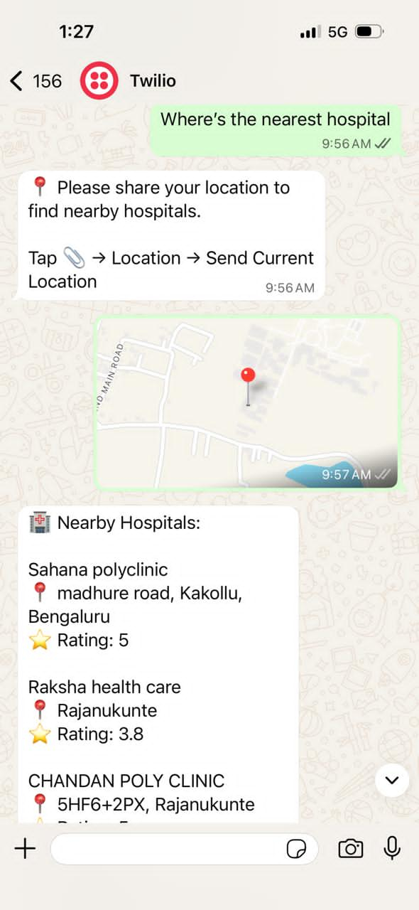
WhatsApp Interface

Slide 15
Social, Legal, Ethical, Sustainability and Safety aspects
The system contributes socially by improving healthcare awareness and accessibility. Legally, it avoids liability by not providing diagnosis or prescriptions. Ethically, it ensures that responses are safe and prevents misinformation. From a sustainability perspective, it offers a scalable digital healthcare solution. The system also incorporates safety mechanisms such as emergency detection and response filtering to ensure responsible usage.

Slide 16
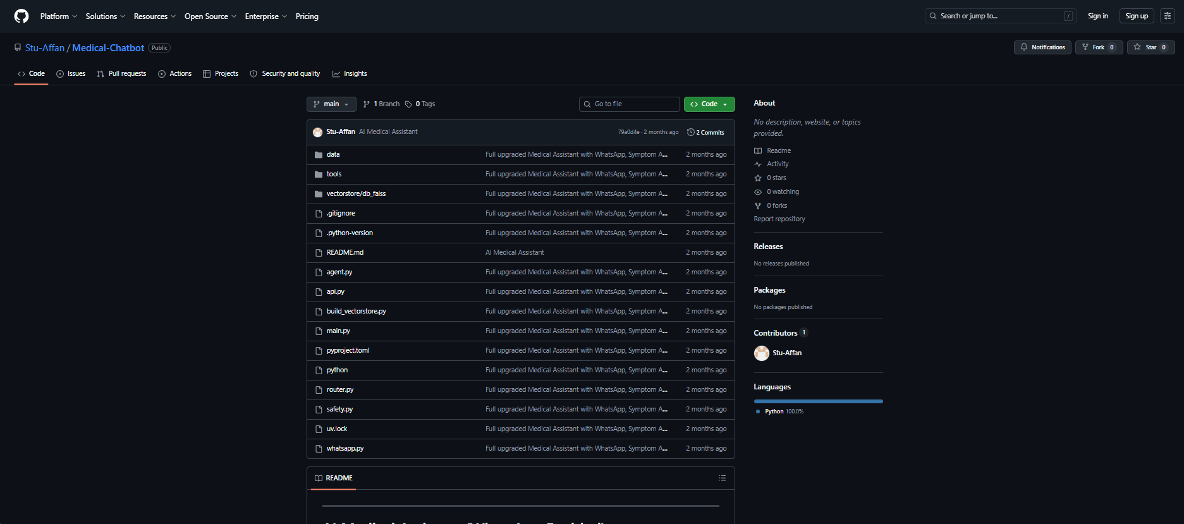
Github Link
https://github.com/Stu-Affan/Medical-Chatbot

Slide 17
Conclusion
The project successfully develops an AI-driven public health chatbot that combines Retrieval-Augmented Generation with deterministic routing to provide reliable and safe healthcare information. It improves accessibility and reduces misinformation in underserved communities. Future enhancements include multilingual support, voice-based interaction, integration with healthcare systems, and real-time health monitoring features.

Slide 18
References
[1] L. Laranjo et al., “Conversational agents in healthcare: A systematic review,” Journal of the American Medical Informatics Association, vol. 25, no. 9, pp. 1248–1258, 2018.
[2] T. W. Bickmore et al., “Safety first: Conversational agents for health information,” Journal of Biomedical Informatics, vol. 82, pp. 1–9, 2018.
[3] L. Wilson and M. Marasoiu, “The development and use of chatbots in public health: Scoping review,” JMIR Human Factors, vol. 9, no. 4, p. e35882, 2022.
[4] F. Branda et al., “The role of AI-based chatbots in public health emergencies: A narrative review,” Future Internet, vol. 17, no. 4, p. 145, 2025.
[5] K. Singhal et al., “Large language models encode clinical knowledge,” Nature, vol. 620, pp. 172–180, 2023.

Slide 19
References
[6] Z. Ji et al., “Survey of hallucination in natural language generation,” ACM Computing Surveys, vol. 55, no. 12, pp. 1–38, 2023.
[7] P. Lewis et al., “Retrieval-augmented generation for knowledge-intensive NLP tasks,” in Advances in Neural Information Processing Systems (NeurIPS), vol. 33, pp. 9459–9474, 2020.
[8] G. Izacard and E. Grave, “Leveraging passage retrieval with generative models for open-domain question answering,” in Proc. EACL, pp. 874– 880, 2021.
[9] A. S. Miner et al., “Chatbots in the fight against the COVID-19 pandemic,” npj Digital Medicine, vol. 3, no. 65, pp. 1–4, 2020.
[10] A. Devaraj et al., “Evidence-based clinical decision support using natural language processing,” Journal of Biomedical Informatics, vol. 128, p. 104002, 2022.

Slide 20


